Slide 1

Introduction to Artificial Neural Networks
Deep Learning
Presentation Courtesy: DataBricks

Slide 2
Introduction to Neural Networks
What is Deep Learning?
What can Deep Learning do for you? What are artificial neural networks?
Let’s start with a perceptron…
Understanding the effect of activation functions
•
•
•
•
•

Slide 3






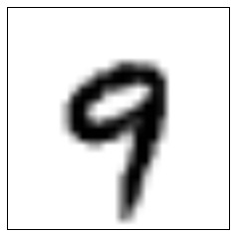



Convolutional Neural Networks
28 x 28
28 x 28
14 x 14
Dropout
0
1
Fully Connected
Dropout
Convolution 32 filters
Convolution 64 filters
Subsampling Stride (2,2)
8
9
Feature Extraction
Classification

Slide 4
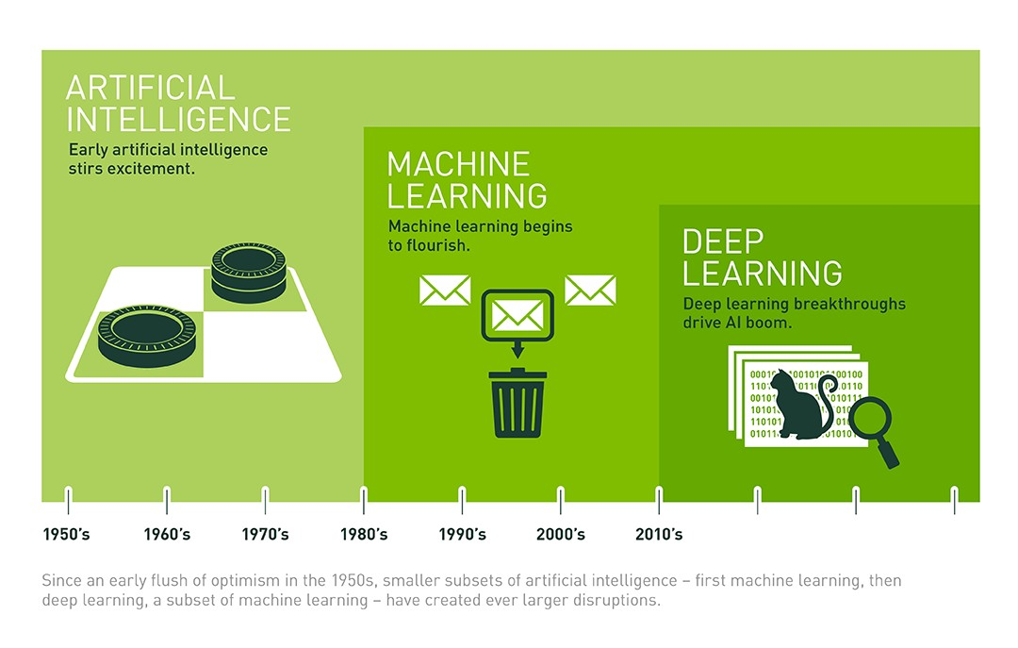
Deep Learning, ML, AI, … oh my!
Source: http://bit.ly/2suufGJ

Slide 5
Deep Learning, ML, AI, … oh my!
Artificial Intelligence
Artificial Intelligence is human intelligence exhibited by machines
The world’s best Dota 2 players just got destroyed by a killer AI from Elon Musk’s startup
Elon Musk-funded Dota 2 bots spank top-tier humans, and they know how to trash talk

Slide 6
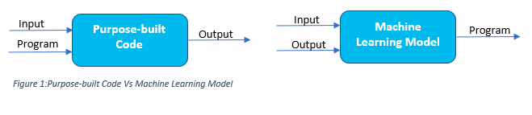
Deep Learning, ML, AI, … oh my!
Machine Learning
Field of study that gives computers the ability to learn without being explicitly programmed.
Source: https://bit.ly/2NnyrOz

Slide 7
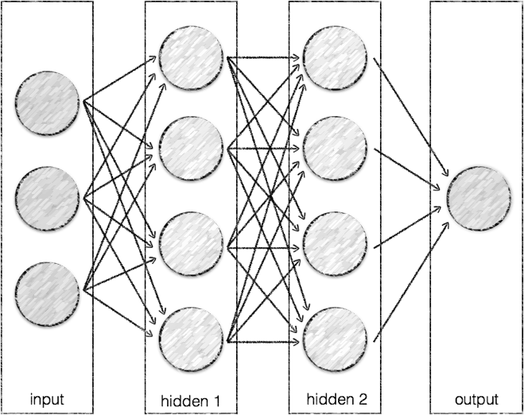
Deep Learning, ML, AI, … oh my!
Deep Learning
Using deep neural networks to implement machine learning

Slide 8
Ask not what AI can do for you?

Slide 9
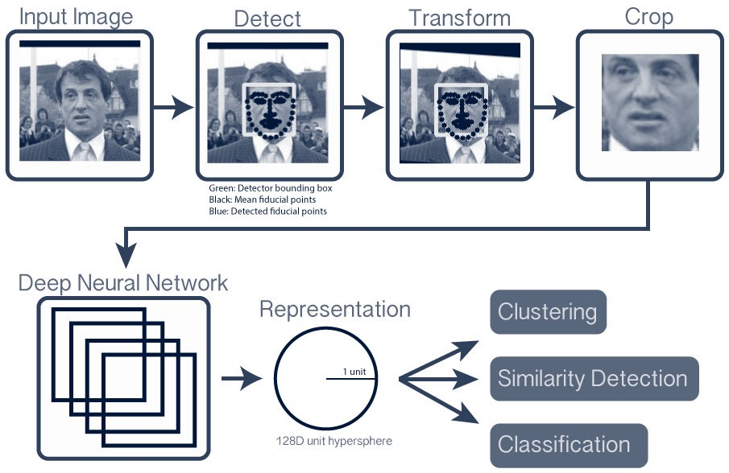
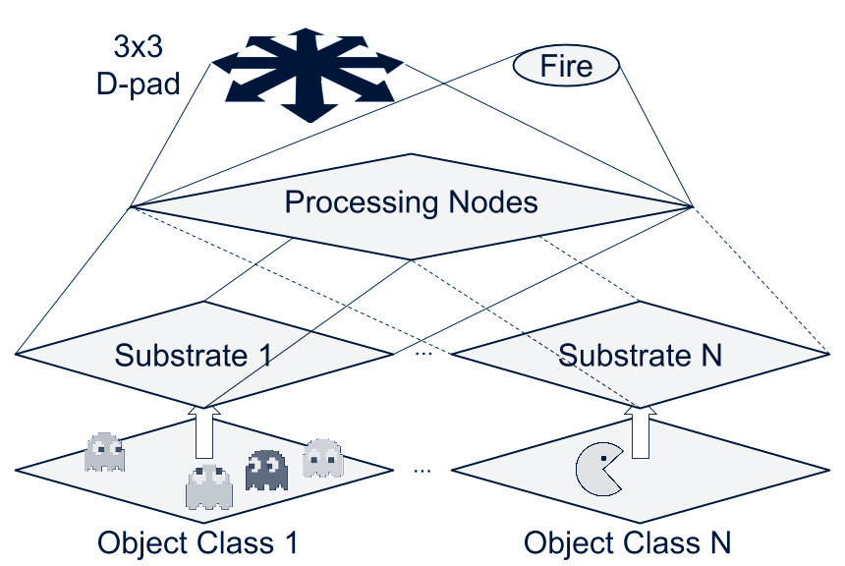
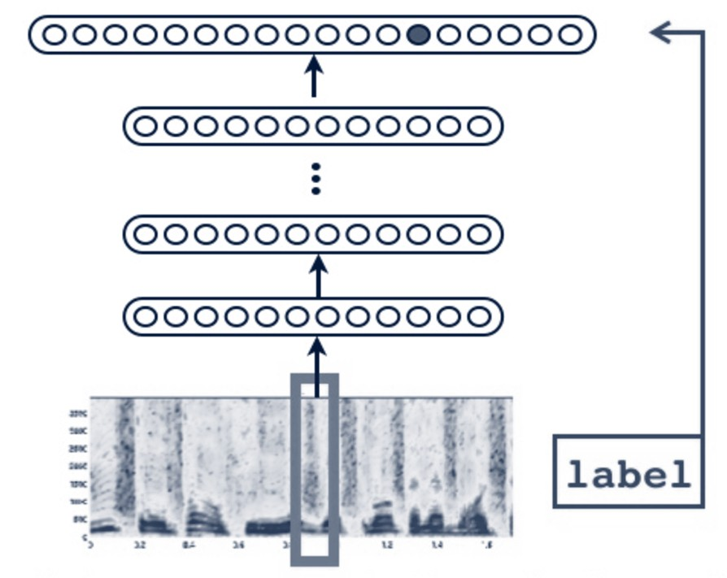
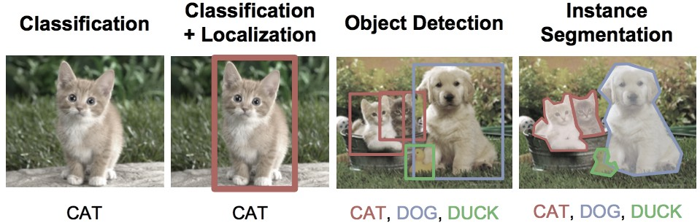
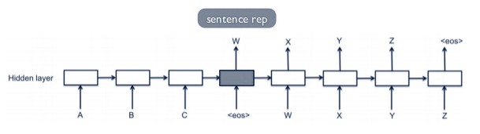
Applications of neural networks
Object Recognition: Facial Game Playing
Object Recognition: Speech
Object Classification
Language Translation

Slide 10
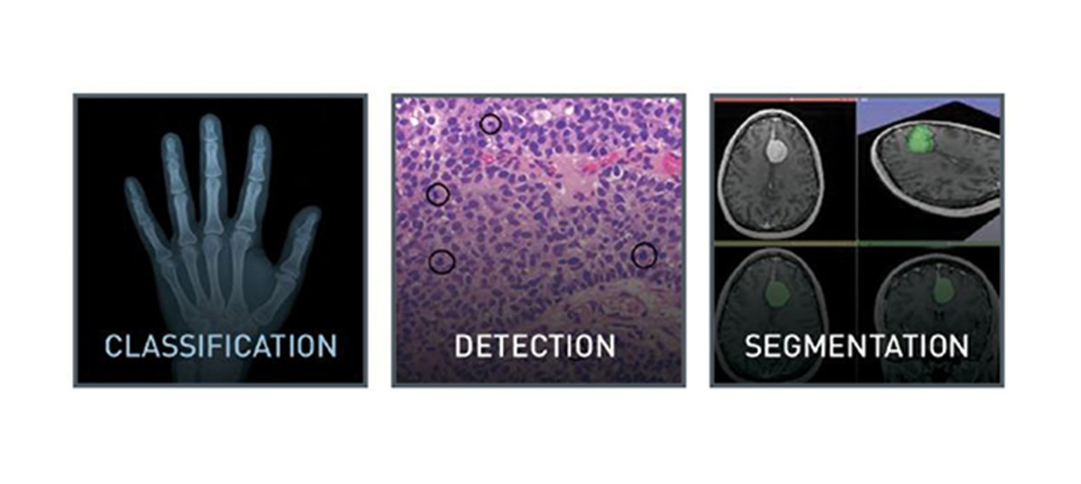
Healthcare
Source: http://bit.ly/2BXF5sR

Slide 11
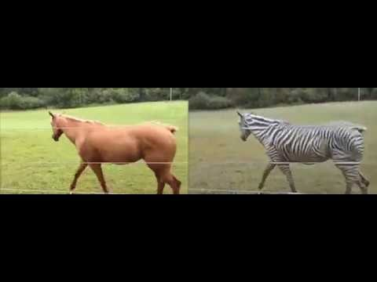
Faking videos
Turning a horse video into a zebra video in real time using GANs
Source: https://youtu.be/JzgOfISLNjk

Slide 12
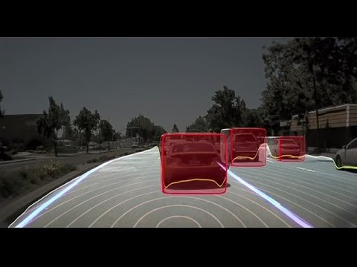
Self-driving cars
Source: https://youtu.be/URmxzxYlmtg?t=6m30s

Slide 13

What are Artificial Neural Networks?

Slide 14


Conceptually, what are artificial neural networks?
A neuron receives a signal, processes it, and propagates the signal (or not)
The brain is comprised of around 100 billion neurons, each connected to ~10k other neurons: 10¹⁵ synaptic connections
ANNs are a simplistic imitation of a brain comprised of dense net of simple structures
Source: http://bit.ly/2jjGlNd

Slide 15
Conceptual mathematical model
•
•
Receives input from n sources Computes weighted sum
h₁ = x₁w₁ + x₂w₂ + . . . x_{n}w_{n}
Passes through an activation function Sends the signal to m succeeding neurons
w
o₁ o₂
. . . ³
o_{m}
1
w
2
w₃
f( ∑ )
∑
o
. . .
w_{n}
•
•

Slide 16
“Parallels”
A single neuron in the brain is an incredibly complex machine that even today we don’t understand. A single “neuron” in a neural network is an incredibly simple mathematical function that captures a minuscule fraction of the complexity of a biological neuron. So to say neural networks mimic the brain, that is true at the level of loose inspiration, but really artificial neural networks are nothing like what the biological brain does.
Andrew Ng
Medium Article: Google Brain’s Co-inventor Tells Why He’s Building Chinese Neural Networks

Slide 17
“Parallels”
A single neuron in the brain is an incredibly complex machine that even today we don’t understand. A single “neuron” in a neural network is an incredibly simple mathematical function that captures a minuscule fraction of the complexity of a biological neuron. So to say neural networks mimic the brain, that is true at the level of loose inspiration, but really artificial neural networks are nothing like what the biological brain does.
Andrew Ng
Medium Article: Google Brain’s Co-inventor Tells Why He’s Building Chinese Neural Networks

Slide 18
Artificial Neural Network
Organized into layers of neurons as a black- box model
Typically 3 or more: input, hidden and output

Slide 19
Perceptron
Simplified (binary) artificial neuron
Do I snowboard this weekend?
x₁ → Is the weather good? x₂ → Is the powder good?
x₃ → Am I in the mood to drive?
𝑥₁
𝑥₂
?
𝑜𝑢𝑡𝑝𝑢𝑡
𝑥₃

Slide 20
Perceptron
Simplified (binary) artificial neuron with weights
𝑥₁
w₁
w
0, ∑^{𝑛} 𝑤_{𝑗}𝑥_{𝑗} ≤ 𝑡h𝑟𝑒𝑠h𝑜𝑙𝑑
𝑥₂
2
?
output=
𝑗=0
output
1, ∑^{𝑛} 𝑤_{𝑗}𝑥_{𝑗} > 𝑡h𝑟𝑒𝑠h𝑜𝑙𝑑
w₃
𝑗=0
𝑥₃

Slide 21
Perceptron
Simplified (binary) artificial neuron; no weights
Do I snowboard this weekend?
1
𝑥
𝑡h𝑟𝑒𝑠h𝑜𝑙𝑑 = 1
1
x = 1 (good weather)
1
x₂ = 1 (a lot of powder) x₃ = 0 (driving sucks)
1
𝑥₂
?
𝑜𝑢𝑡𝑝𝑢𝑡
1
∑ 𝑤_{𝑗} = 2
𝑥
0
3
𝑗

Slide 22
Perceptron
Simplified (binary) artificial neuron; add weights
Persona: Après-ski’er
Do I snowboard this weekend?
3 𝑥 1
𝑤 𝑥
𝑡h𝑟𝑒𝑠h𝑜𝑙𝑑 = 5
1 1
x = 1 (good weather)
1
w₁ = 3
x₂ = 1 (a lot of powder) w₂ = 1
x₃ = 0 (driving sucks)
w₃ = 5
𝑤₂𝑥₂
?
𝑜𝑢𝑡𝑝𝑢𝑡
0
1 𝑥 1
𝑤₃𝑥₃
∑ w_{j}x_{j} = 3 + 1 + 0 = 4
5 𝑥 0
j

Slide 23
Perceptron
Simplified (binary) artificial neuron; add weights
Persona: Shredder
Do I snowboard this weekend?
2 𝑥 1
𝑤 𝑥
𝑡h𝑟𝑒𝑠h𝑜𝑙𝑑 = 5
1 1
x = 1 (good weather)
1
w₁ = 2
x₂ = 1 (a lot of powder) w₂ = 6
x₃ = 0 (driving sucks)
w₃ = 1
𝑤₂𝑥₂
?
𝑜𝑢𝑡𝑝𝑢𝑡
1
6 𝑥 1
𝑤₃𝑥₃
∑ w_{j}x_{j} = 2 + 6 + 0 = 8
1 𝑥 0
j

Slide 24

Introducing Bias
Perceptron needs to take into account the bias
0, 𝑤𝑥 + 𝑏 ≤ 0
1, 𝑤𝑥 + 𝑏 > 0
=
{
where b is how easy it is to get the perceptron to fire
e.g. Shredder has a strong positive bias to go to Whistler while Après-Ski’er bias is not as strong

Slide 25
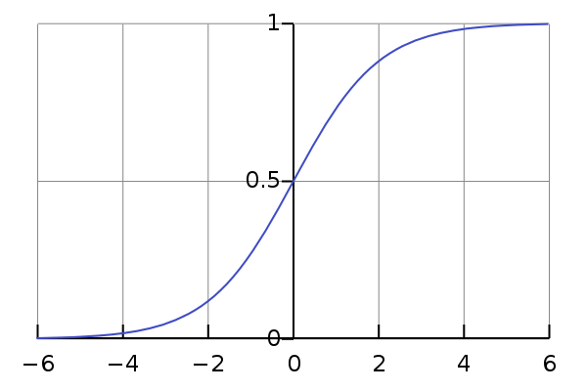
Sigmoid Neuron
The more common artificial neuron
𝑥₁
𝑤₁
𝑤₂
𝑥₂
?
𝑜𝑢𝑡𝑝𝑢𝑡
𝑤₃
σ(wx + b)
𝑥₃
Instead of [0, 1], now (0…1)
Where output is defined by σ(wx + b)

Slide 26
Sigmoid Neuron
Persona: Shredder
1
𝑥₁
Do I snowboard this weekend?
x₁ = 1 (good weather)
w₁ = 0.3
x₂ = 1 (a lot of powder) w₂ = 0.6
𝑤₁
𝑤₂
1
𝑥₂
?
𝑜𝑢𝑡𝑝𝑢𝑡
^{𝑤3} ? = σ(wx + b)
𝑥₃
= σ(1x0.3 + 1x0.6 + 0x0.1)
x = 0 (driving sucks)
0
3
w₃ = 0.1
= σ(0.9)
= 0.7109

Slide 27
Simplified Two-Layer ANN
Do I snowboard this weekend?
x₁ → Apres Ski′er x₂ → Shredder
h₁ → weather h₂ → powder h₃ → driving
Input
Hidden
Output

Slide 28
Simplified Two-Layer ANN
0.8
0.6
0.8
1
h₁ = σ(1x0.8 + 1x0.6) = 0.80 h₂ = σ(1x0.2 + 1x0.9) = 0.75 h₃ = σ(1x0.7 + 1x0.1) = 0.69
0.2
0.9
0.7
0.1
0.75
1
0.69

Slide 29
Simplified Two-Layer ANN
0.8
0.6
0.8
0.2
out = σ(0.2x0.8 + 0.8x0.75 + 0.5x0.69)
1
0.2
0.9
0.7
0.1
0.8
0.75
0.75
= σ(1.105)
= 0.75
1
0.5
0.69

Slide 30
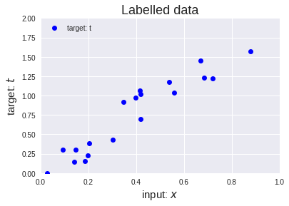
Cost function
For this linear regression example, to determine the best p (slope of the line) for
y = x ⋅ p
we can calculate the cost function, such as Mean Square Error, Mean absolute error, Mean bias error, SVM Loss, etc.
For this example, we’ll use sum of squared absolute differences
cost = ∑ | t − y |²
Source: https://bit.ly/2IoAGzL

Slide 31
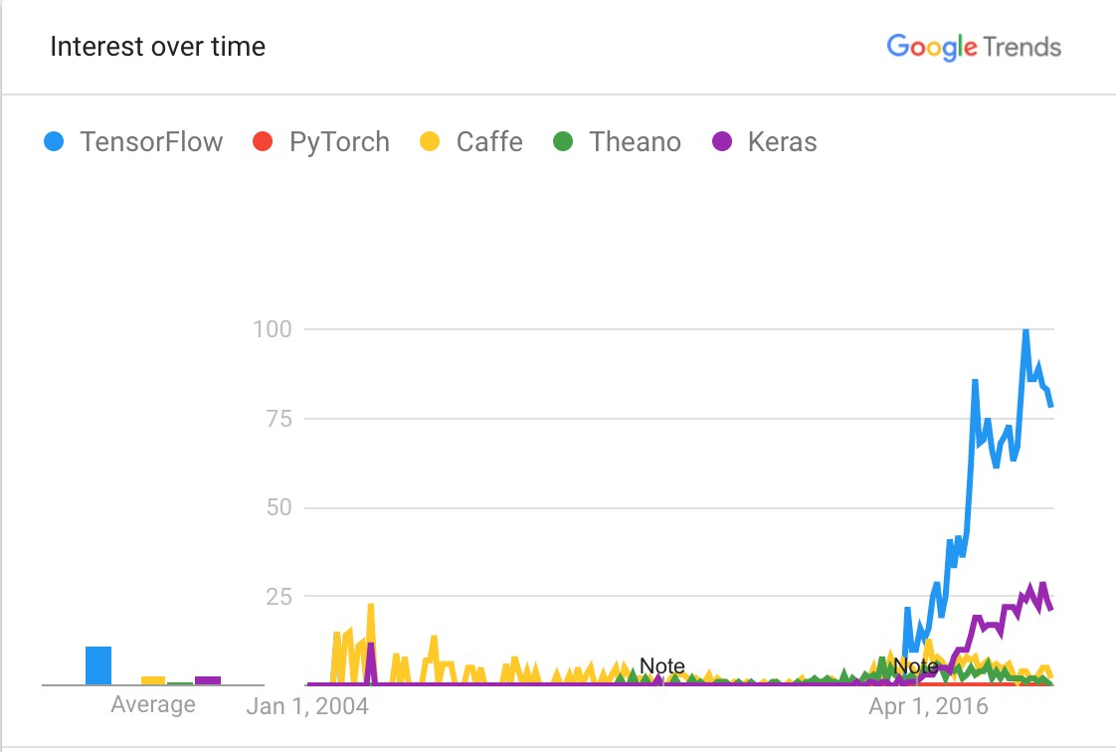
What is TensorFlow
•
Open source software library for numerical computation using data flow graphs
Based loosely on neural networks Built in C++ with a Python interface Quickly gained high popularity Supports GPU computations
•
•
•
•

Slide 32

What is Keras
Python Deep Learning Library High level neural networks API
Runs on top of TensorFlow, CNTK, or Theano
Simpler and easier to use making it easier for rapid prototyping
•
•
•
•

Slide 33
